Slide 1
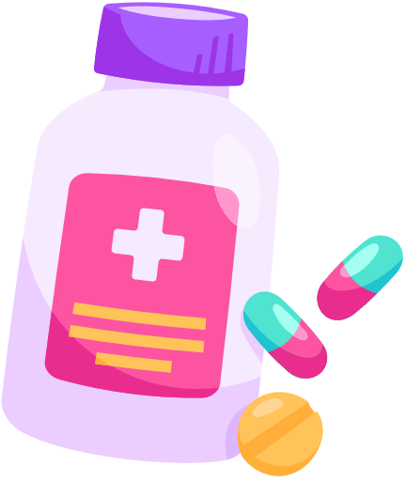






Cloud And Blockchain Powered Hospital Management: A New Era Of Healthcare Solutions
By PRARTHANAH G
2022PECCS240
211422104345
CSE-C (III YEAR)

Slide 2

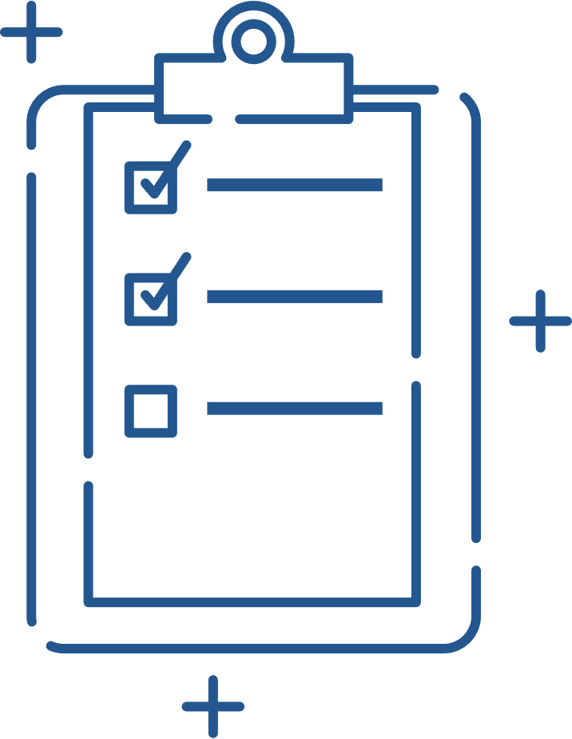

INTRODUCTION
Step into a new era of healthcare accessibility with the launch of an advanced hospital website. This digital platform is crafted to simplify interactions, offering effortless navigation through essential services and information. Designed to empower patients, it provides quick access to medical resources, streamlined appointment scheduling, and personalized support. This evolution in digital presence marks a significant leap forward in enhancing the overall patient experience and ensuring that exceptional healthcare is readily available at your fingertips.

Slide 3


ABSTRACT
The new hospital website enhances digital healthcare by providing an intuitive interface for easy access to appointments, medical information, and patient resources. Designed to streamline interactions and improve user experience, this platform ensures seamless access to essential services. The initiative marks a significant step in modernizing the hospital’s digital presence and improving patient engagement and satisfaction.

Slide 4

EXISTING SYSTEM
The existing hospital website system offers basic functionality, providing essential information about hospital services, departments, and physician profiles. It includes a simple appointment request form and basic contact details for patient inquiries. However, the system is limited in its interactivity and efficiency. Appointment scheduling is managed manually by staff, and access to medical records is restricted, often requiring in-person visits or phone calls. The website's outdated design and lack of integration with modern digital tools hinder its effectiveness in meeting the needs of patients and improving overall user experience.

Slide 5

PROPOSED SYSTEM
The proposed hospital website system incorporates cloud and blockchain technologies to enhance both functionality and security. Cloud computing will provide scalable, reliable access to services and patient data, while blockchain ensures secure, transparent management of medical records and transactions. Java will be used as the primary programming language, facilitated by NetBeans for efficient development and coding. SQLyog Community will handle database management, offering advanced tools for SQL querying and optimization. This integrated approach aims to streamline patient interactions, bolster data security, and modernize the overall digital experience.

Slide 6
MODULES
Doctor Module
Login: Secure access for doctors with credentials.
View Profile: Update and view personal and professional details.
Read Sensor Patient Data & Add: Access and input real-time sensor data from patients.
View Sensor Patient Details: Review detailed patient sensor data and trends.
View Key Request: Manage and review requests for data access or medical keys.
View Clinical Reports: Access and review patient clinical reports and test results.
Logout: Securely exit the system to protect data.

Slide 7

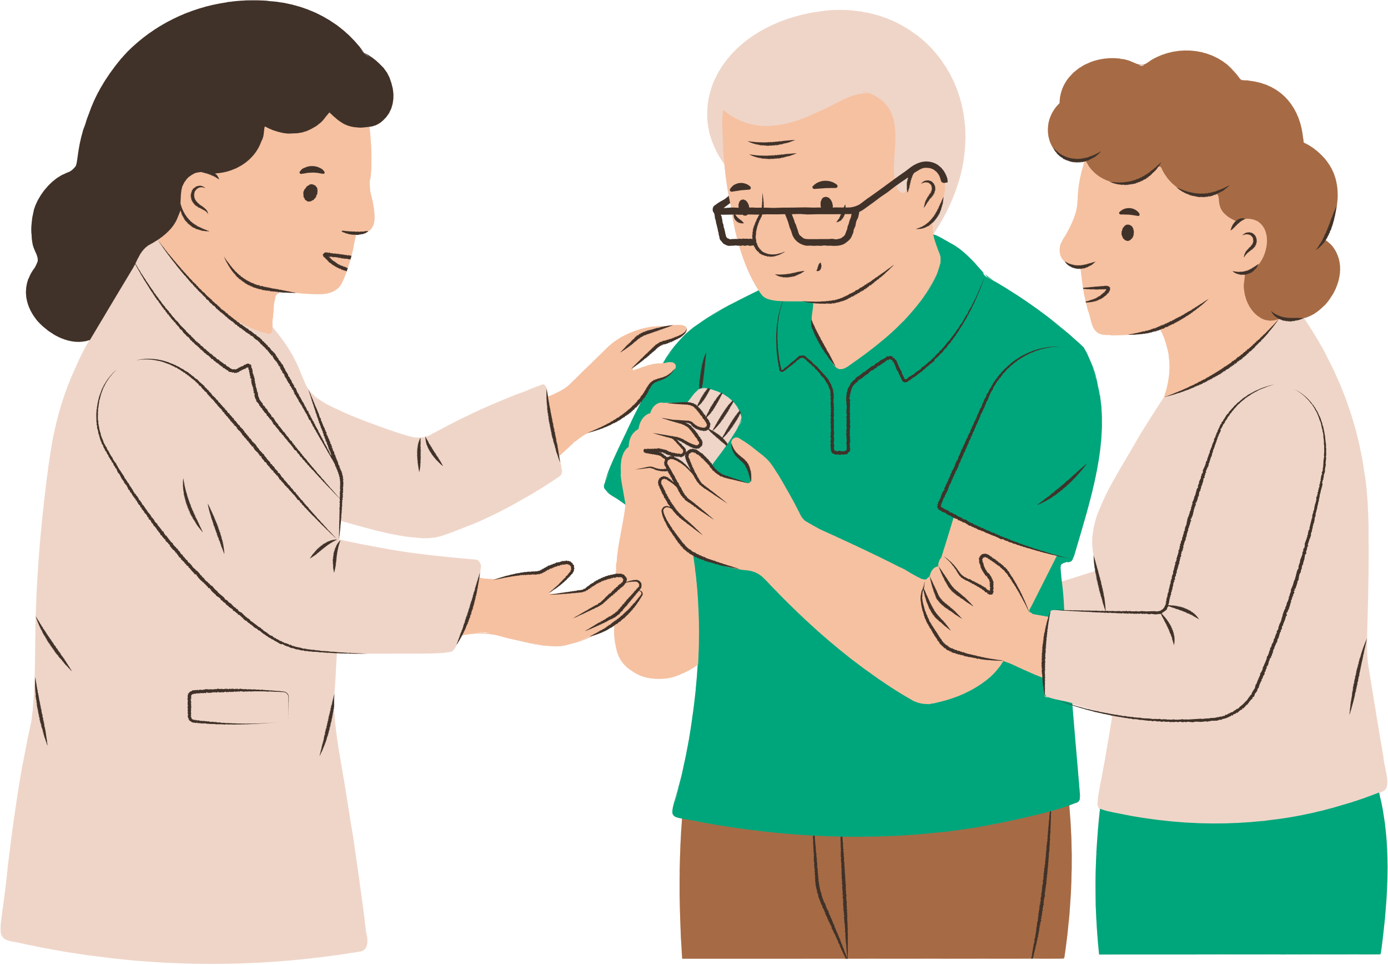
Patient Sensor Module
Register: Sign up and configure sensor devices for patient monitoring.
View Profile: Access and update personal details related to sensor use.
Read Sensor Patient Details: Review data collected from patient sensors, such as vital signs.
View Key Request: Manage and view requests for access to sensor data or medical keys.
View Clinical Reports: Access clinical reports related to sensor data and patient health. Logout: Securely exit the system to protect personal and medical information.

Slide 8


Cloud Server Module
Login: Secure access to the cloud server with credentials.
View and Authorize Doctor: Review and approve doctor access requests.
View Clinical Report: Access and review clinical reports stored on the cloud.
View Patient Details: Access detailed patient information.
Trace Patients by Blockchain: Track and verify patient data transactions using blockchain technology.
View Access Control Request: Manage and review requests for data access permissions.
View Encryption Key Requests: Handle requests for encryption keys used in data protection.
View Key Transaction: Monitor and review transactions involving security keys.
View Result in Chart: Visualize data and results using charts for better analysis.
Logout: Securely exit the system to protect sensitive information.

Slide 9
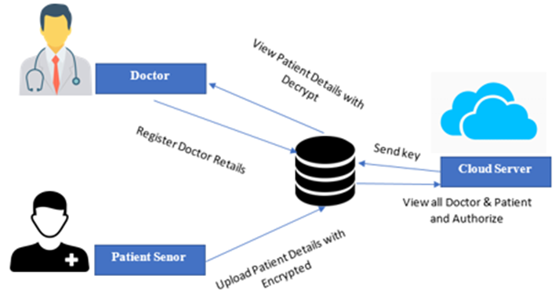
ARCHITECTURE DIAGRAM

Slide 10
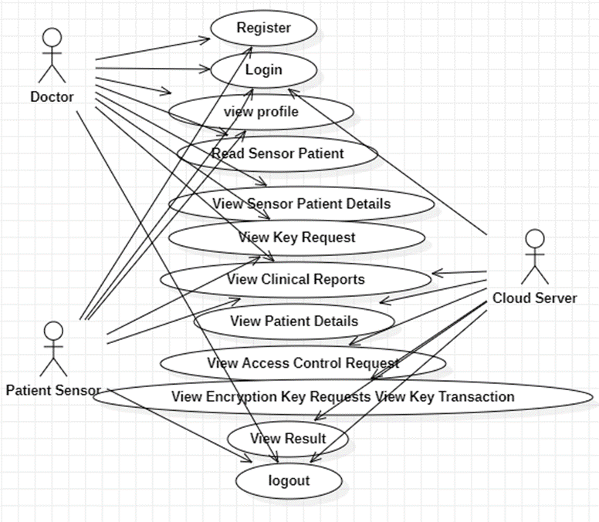
USE CASE DIAGRAM

Slide 11
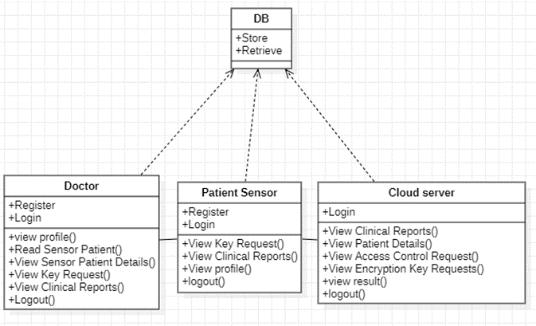
CLASS DIAGRAM

Slide 12
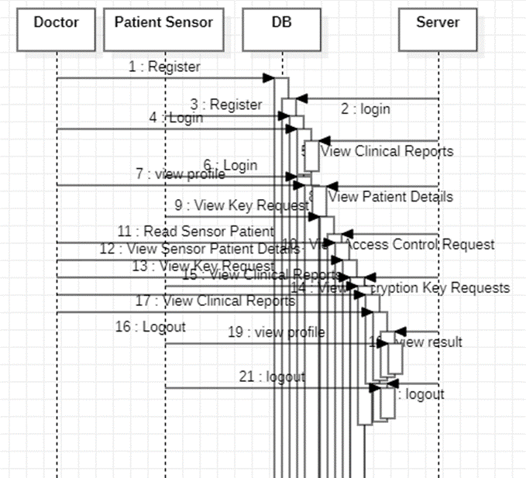
SEQUENCE DIAGRAM

Slide 13
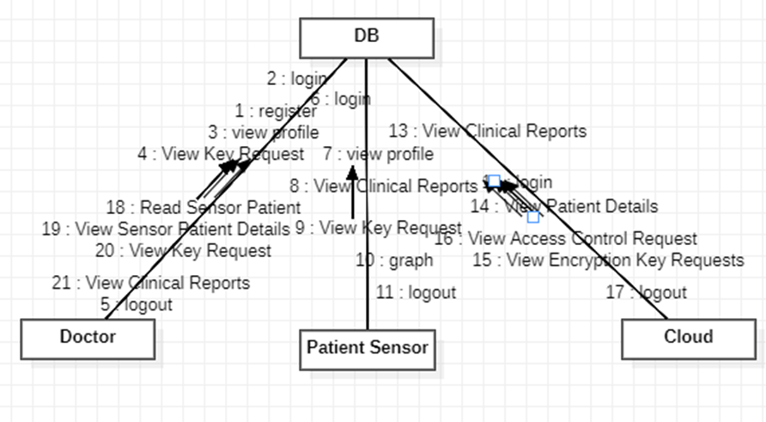
COLLABORATION DIAGRAM

Slide 14
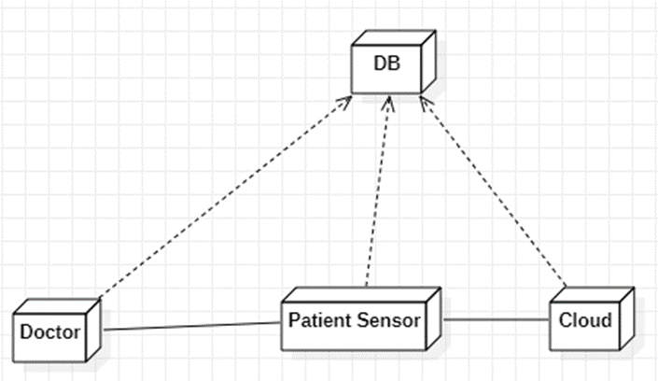
DEPLOYMENT DIAGRAM

Slide 15
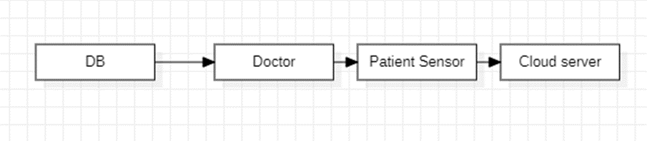
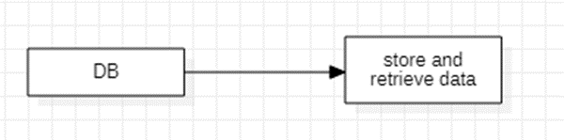
DATA FLOW DIAGRAM
LEVEL 0:
LEVEL 1:

Slide 16
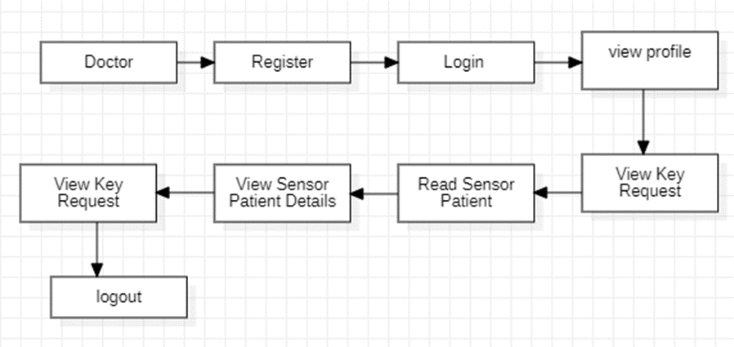
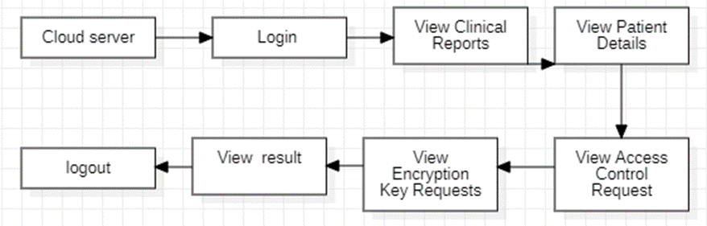
LEVEL 2:
LEVEL 3:

Slide 17
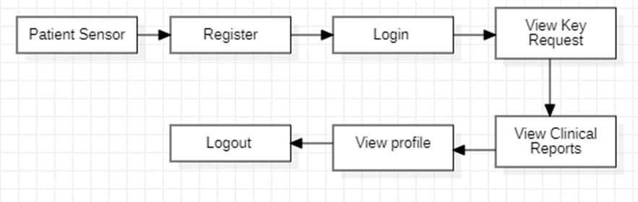
LEVEL 4:

Slide 18



CONSULTANCY PROJECT
S.S. NURSING HOME
ADDRESS:
No.7,
S S Hopital street,
Balaji Avenue,
Seneerkuppam,
Chennai-600056.
Contact number:
8939651516

Slide 19
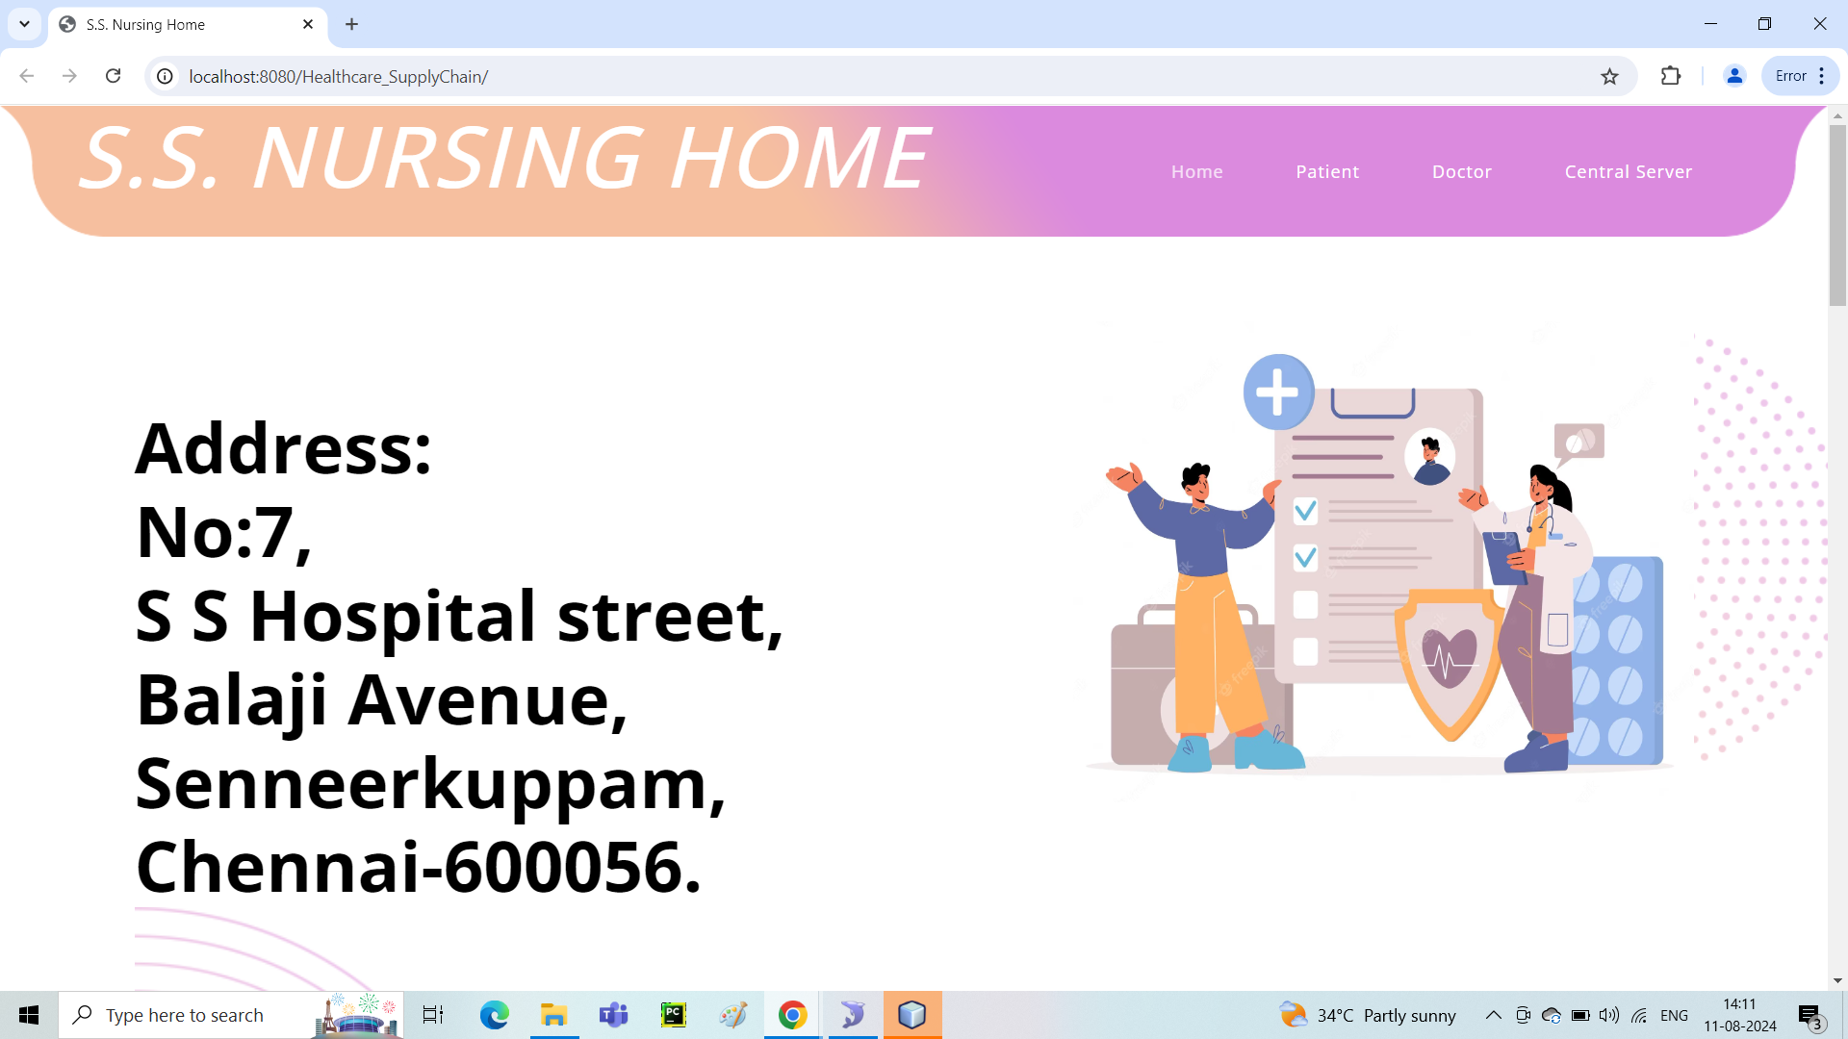
WEBSITE FRONT PAGE

Slide 20


CONCLUSION
In conclusion, the integration of the Doctor, Patient Sensor, and Cloud Server modules offers a robust and streamlined healthcare management solution. The Doctor Module enhances efficiency in accessing and managing patient data, the Patient Sensor Module facilitates real-time monitoring and data handling, and the Cloud Server Module ensures secure and organized data management through advanced technologies. This cohesive system improves patient care, ensures data security, and modernizes healthcare operations, leading to more effective and responsive healthcare delivery.

Slide 21


